Slide 1

NETFLIX MOVIES AND TV SHOWS DATA EXPLORATION
By
-Jennifer Shalet Sequeira
-Suryakanth Bal

Slide 2
PROBLEM STATEMENT
With the growing popularity of streaming platforms like Netflix, there is an ever-increasing amount of content being added and consumed globally. However, understanding the nature of this content — such as what types of shows are most common, which countries contribute the most, how ratings vary, or how content has evolved over time — remains a challenge.
This project aims to explore and analyze the Netflix Movies and TV Shows dataset to extract meaningful insights about the platform’s content library.

Slide 3
By performing detailed exploratory data analysis (EDA), we seek to:
Identify trends in content type (Movies vs TV Shows)
Examine the distribution of content across countries, ratings, and release years
Analyze the duration of movies and how it relates to ratings and genres
Discover the most common genres, top directors, and prolific countries
Provide visual summaries to help stakeholders understand user preferences and content trends

Slide 4
DATASET
show_id
Unique ID for each entry (e.g., s1, s2, etc.)
type
Indicates whether the content is a Movie or a TV Show
title
Name/title of the show or movie
director
Name of the director(s) of the content
cast
Names of the main actors/actresses, separated by commas
country
Country where the content was produced
date_added
The date when the show or movie was added to Netflix

Slide 5
DATASET
release_year
The original release year of the content
rating
Maturity rating of the content (e.g., TV-MA, PG, R)
duration
Shows duration as:
For Movies: duration in minutes (e.g., "90 min")
For TV Shows: number of seasons (e.g., "2 Seasons")
listed_in
Categories/genres (e.g., Dramas, Action, Kids’ TV)
description
Short summary or synopsis of the show/movie

Slide 6
Why This Dataset Is Useful?
Great for practicing data cleaning, EDA, and visualization.
Helps analyze content trends, audience targeting, and regional content distribution.
Useful for both business and technical insights.

Slide 7
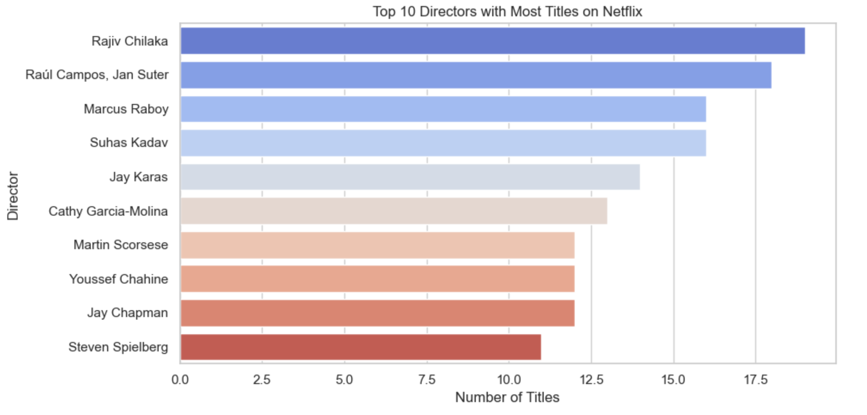
BAR CHART
This bar chart highlights the 10 directors with the highest number of titles available on Netflix. Leading the list is Rajiv Chilaka, followed by Raúl Campos & Jan Suter, and Marcus Raboy. The directors featured in this list are known for creating a wide range of content, including children’s shows, stand-up comedy specials, TV series, and films.

Slide 8
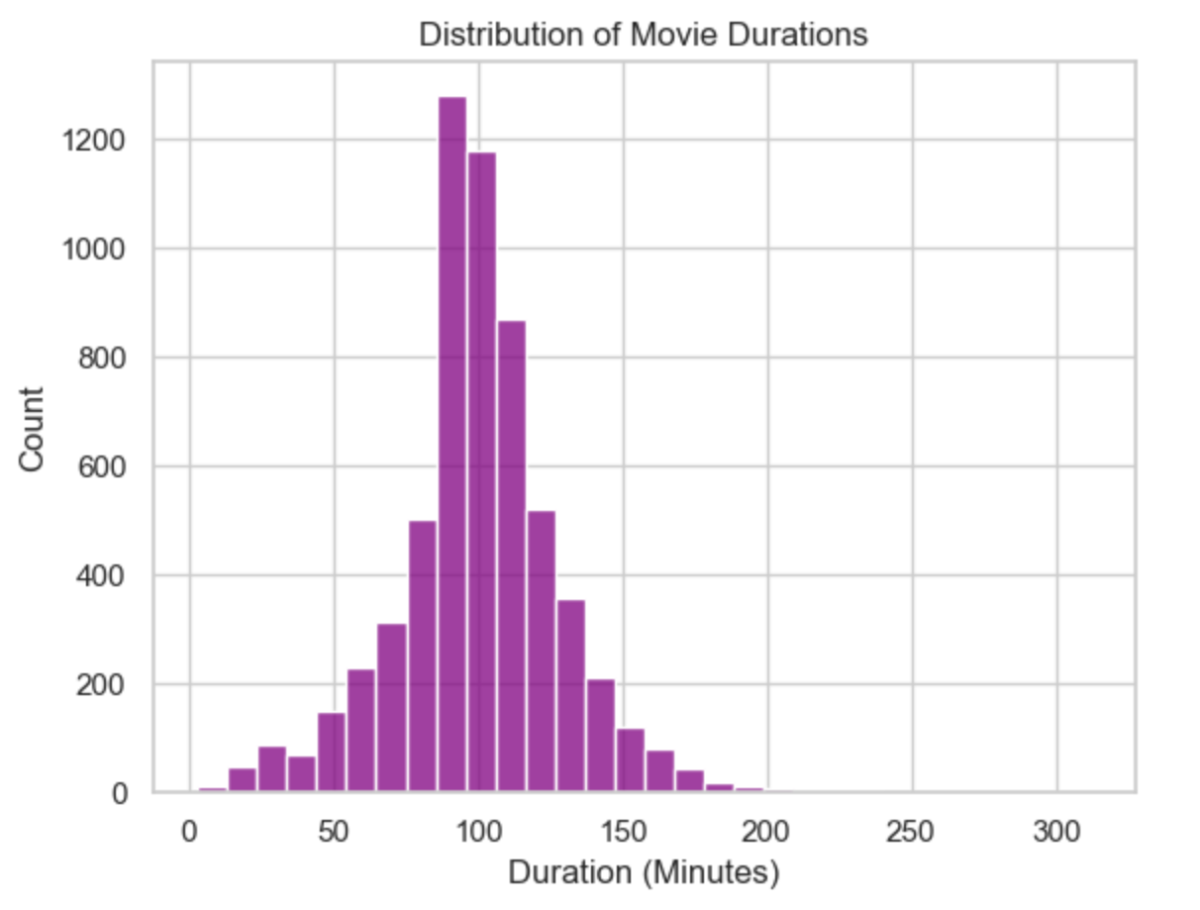
HISTOGRAM
The histogram shows that most Netflix movies have a duration between 75 to 120 minutes, with a peak around 90–100 minutes, indicating that standard feature-length films are the most common.
The distribution is slightly right-skewed, suggesting that while longer movies exist, they are relatively rare. Very few movies are under 40 minutes or over 150 minutes, highlighting Netflix’s focus on conventional movie lengths that align with typical viewer preferences.

Slide 9
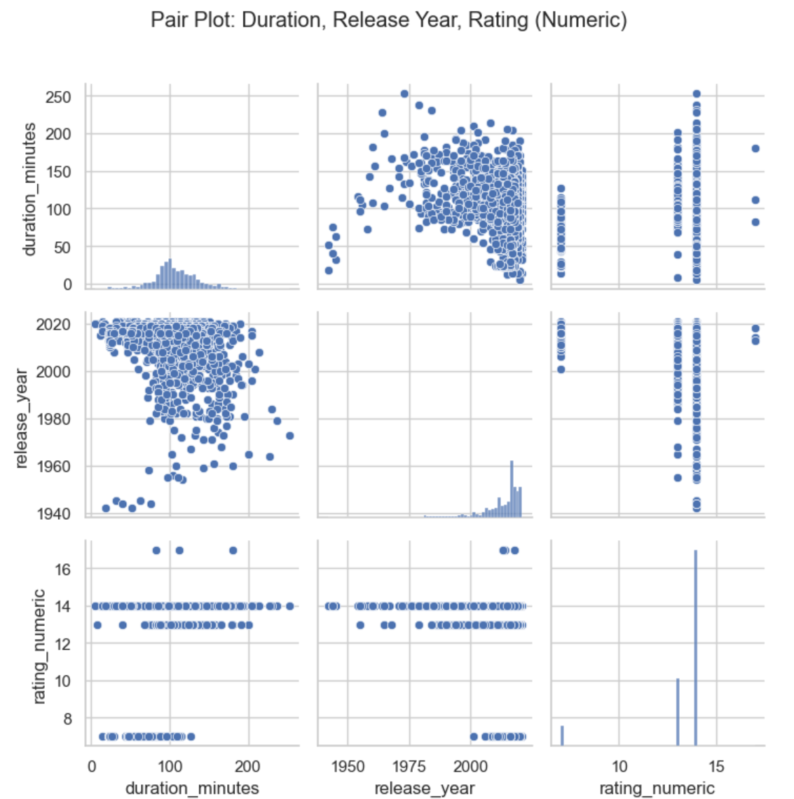
PAIR PLOT
The pair plot illustrates the relationships among movie duration, release year, and numeric rating. Most movies cluster around 80–120 minutes in duration, with a sharp increase in releases after 2000, showing Netflix’s focus on newer content.
The rating values are concentrated at discrete levels, indicating categorical ratings mapped to numbers rather than continuous scores. There is no strong correlation between duration and ratings or between release year and ratings, suggesting that movie length and release date do not significantly influence the assigned rating on Netflix.

Slide 10
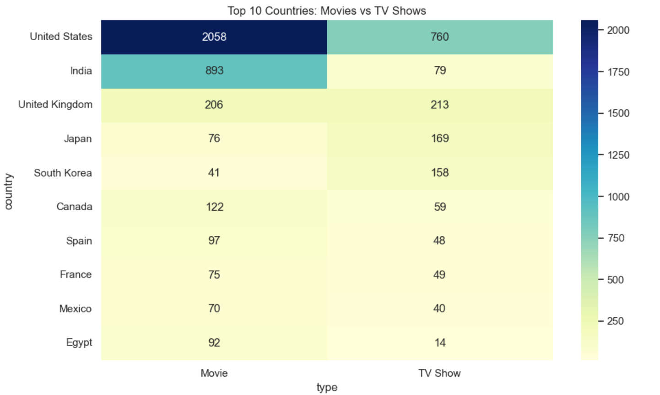
HEATMAP
The heatmap visualization highlights the distribution of Netflix content—movies and TV shows—across the top 10 countries with the highest number of titles. Each cell in the heatmap represents the volume of either movies or TV shows available in a given country, with color intensity indicating quantity.
Overall, movies tend to outnumber TV shows in most countries, but certain markets show a clear shift toward serialized content.

Slide 11
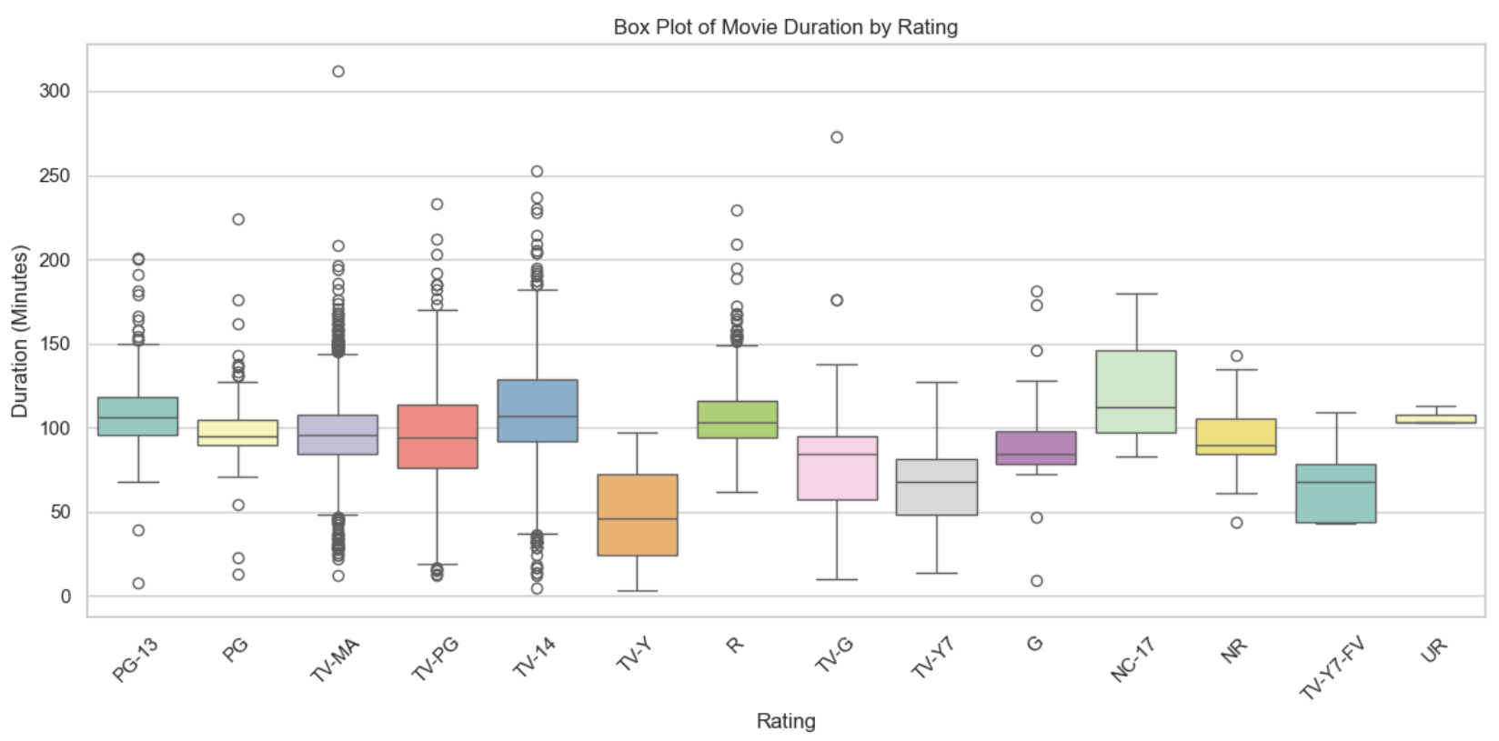
BOX PLOT

Slide 12
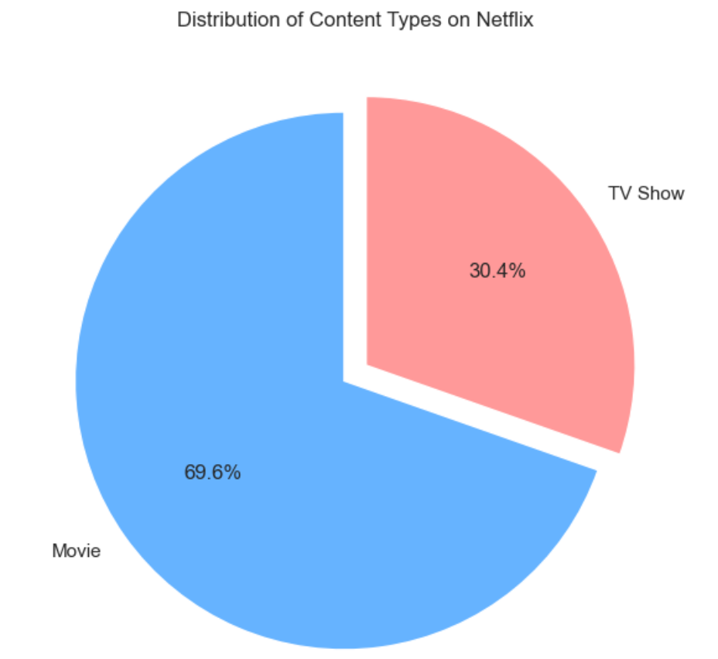
PIE PLOT
This pie chart shows the proportion of Movies and TV Shows available on Netflix.
It helps us understand what type of content dominates the platform. TV Shows occupy a smaller but significant portion.
This distribution reflects Netflix’s focus on feature films, while also maintaining a strong catalog of series.

Slide 13
CONCLUSION
In this Netflix Movies and TV Shows Data Exploration project, we analyzed key aspects of the streaming platform's content library. We discovered that movies dominate the content type, and the United States produces the largest number of titles. Most content is targeted at mature audiences (TV-MA, R ratings), and the volume of releases peaked around 2018–2020. Genre analysis revealed that Dramas, Comedies, and Documentaries are the most common, while duration analysis showed that most movies are between 80–100 minutes long. These insights provide a comprehensive overview of Netflix’s content trends, helping us understand their content strategy, audience focus, and global reach.

Slide 14


